Slide 1

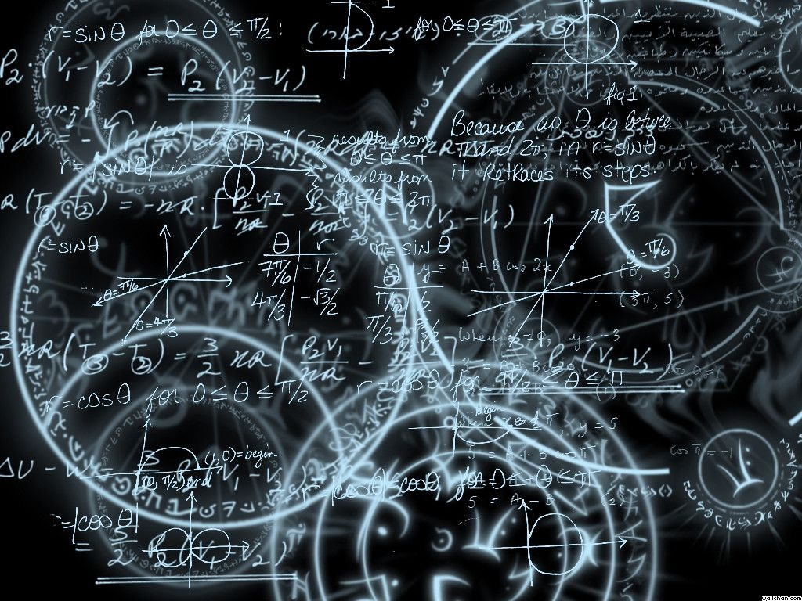
Azərbaycan Dövlət Neft və Sənaye Universiteti
Calculus
Single Variable

Slide 2
Preparation for Calculus:
Graphs and Models

Slide 3
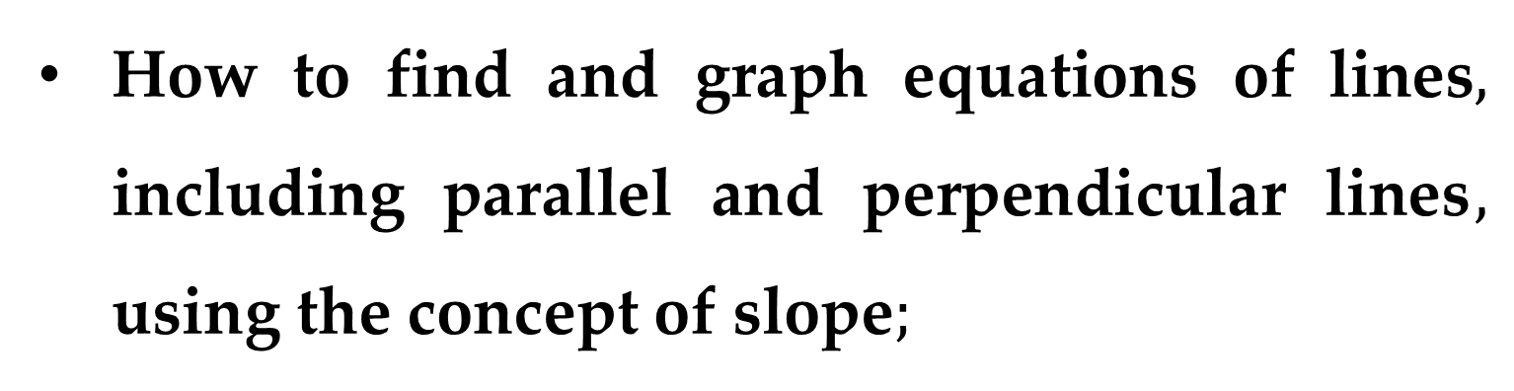
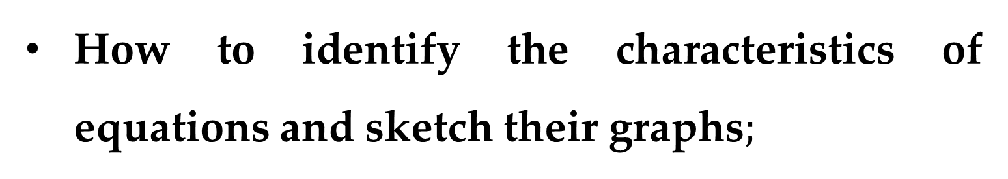
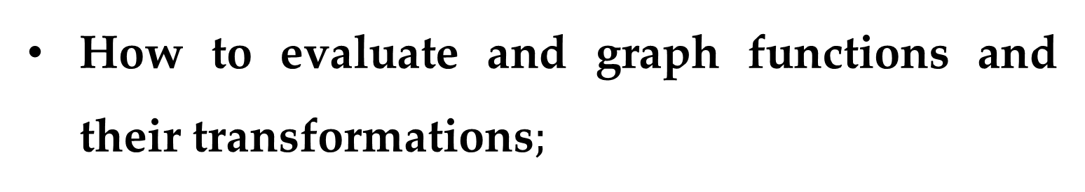
How to identify the characteristics of equations and sketch their graphs$;$
How to find and graph equations of lines$,$ including parallel and perpendicular lines$,$ using the concept of slope$;$
How to evaluate and graph functions and their transformations$;$
How to fit mathematical models to real-life data sets.

Slide 4
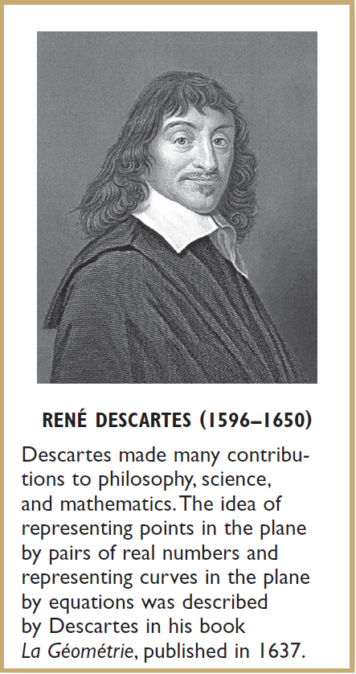
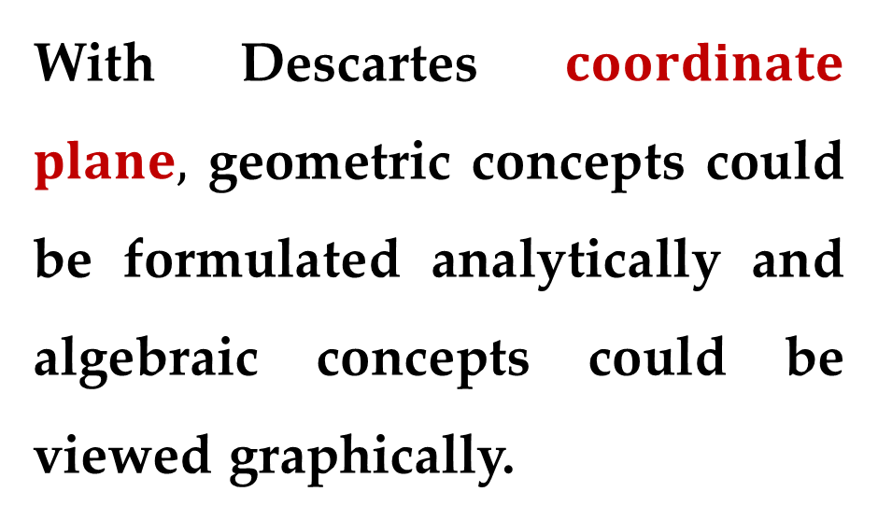
In 1637 the mathematician René Descartes revolutionized the study of mathematics by joining its two major fields — algebra and geometry.
With Descartes $coordinate$ $plane,$ geometric concepts could be formulated analytically and algebraic concepts could be viewed graphically.

Slide 5
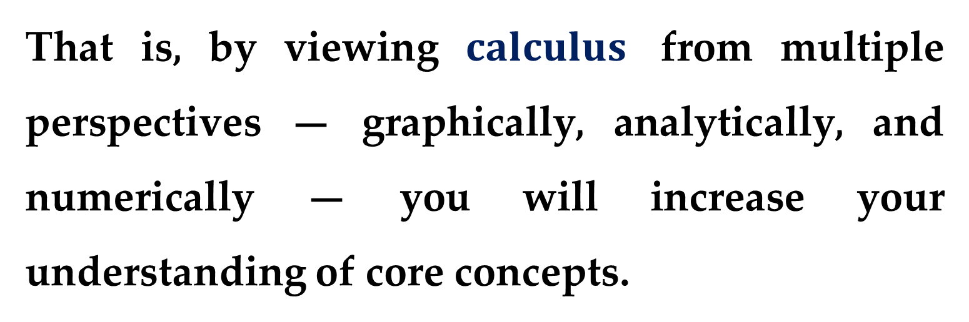
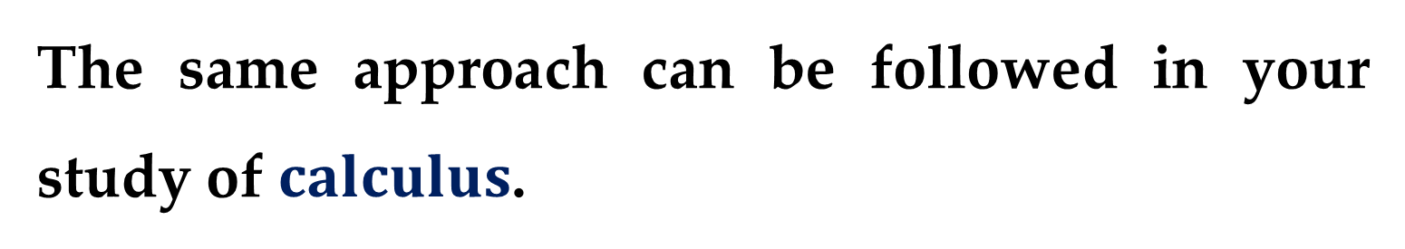
The power of this approach was such that within a century of its introduction, much of calculus had been developed.
The same approach can be followed in your study of $calculus$.
That is, by viewing $calculus$ from multiple perspectives — graphically, analytically, and numerically — you will increase your understanding of core concepts.

Slide 6
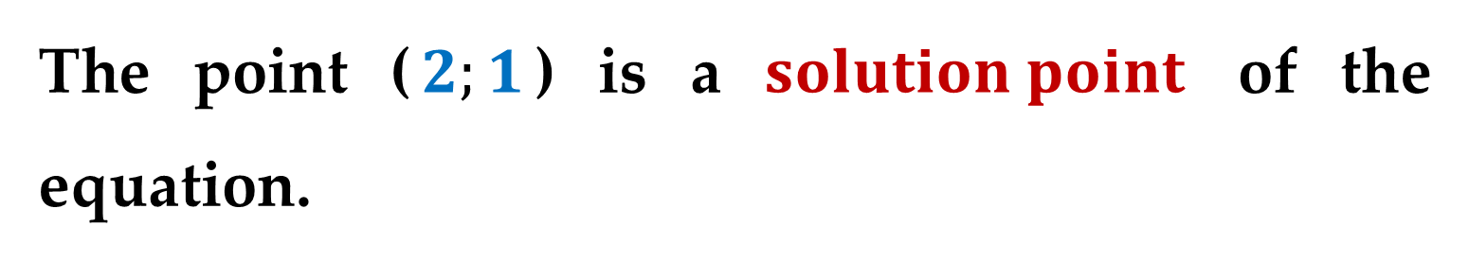

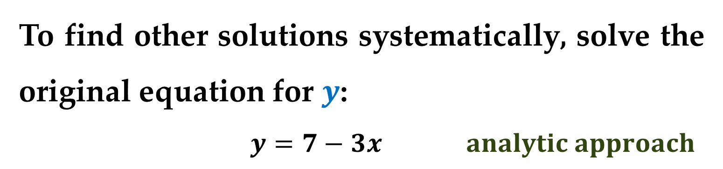
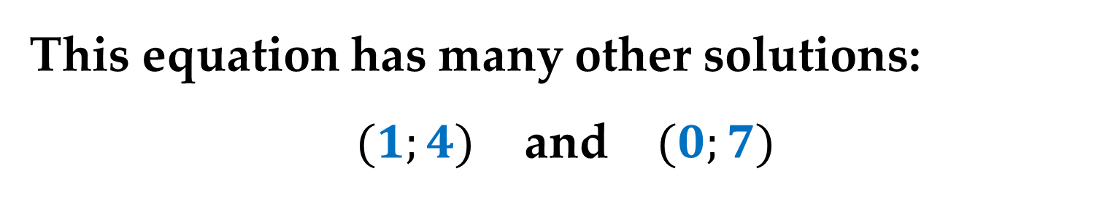
$The Graph of an Equation$
Consider the equation: $3x+y=7$
The point ($2;1$) is a $solution point$ of the equation.
This equation has many other solutions:
$(1;4)$ and $(0;7)$
To find other solutions systematically, solve the original equation for $y$:
$y=7−3x analytic approach$

Slide 7
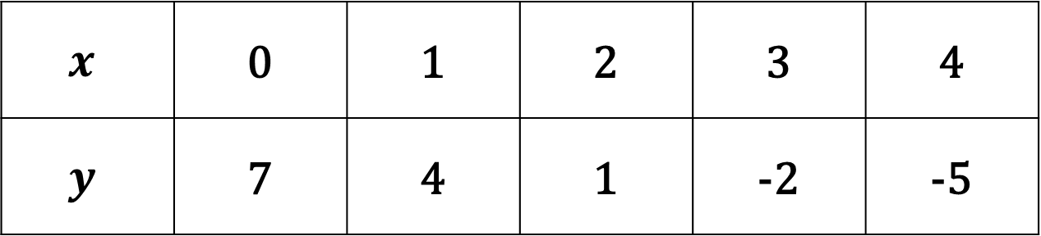
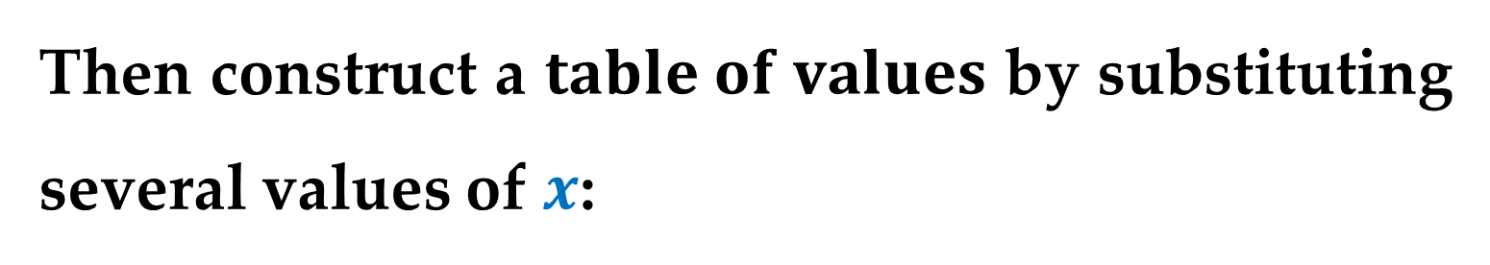
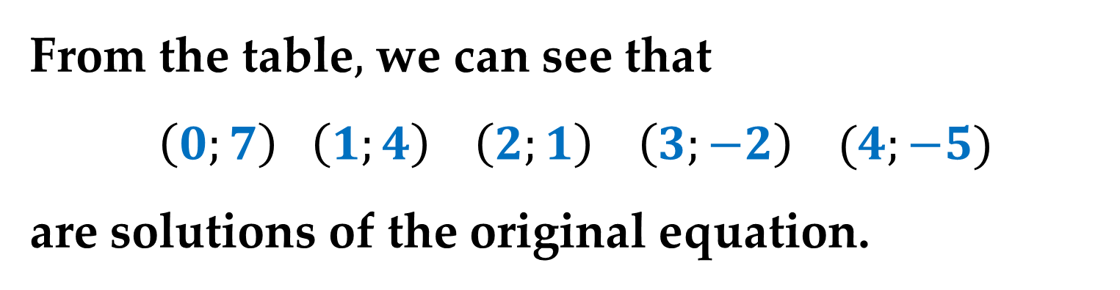
Then construct a $table of values$ by substituting several values of $x$:
$$x$$ | 0 | 1 | 2 | 3 | 4
$$y$$ | 7 | 4 | 1 | -2 | -5
numerical approach
From the table$,$ we can see that
$\left(0;7\right) \left(1;4\right) \left(2;1\right) \left(3;−2\right) (4;−5)$
are solutions of the original equation.

Slide 8
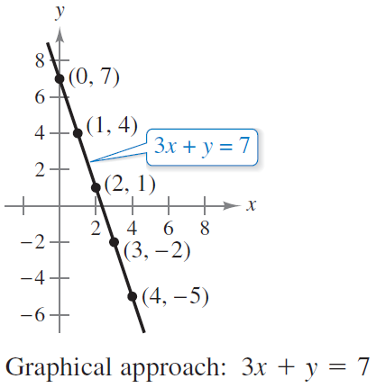
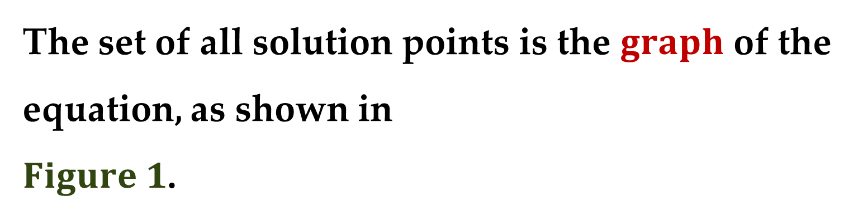
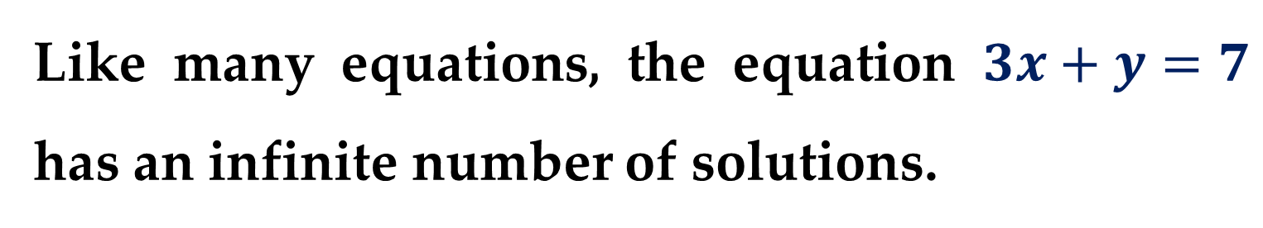
Like many equations, the equation $3x+y=7$ has an infinite number of solutions.
The set of all solution points is the $graph$ of the equation, as shown in
$Figure 1$.

Slide 9
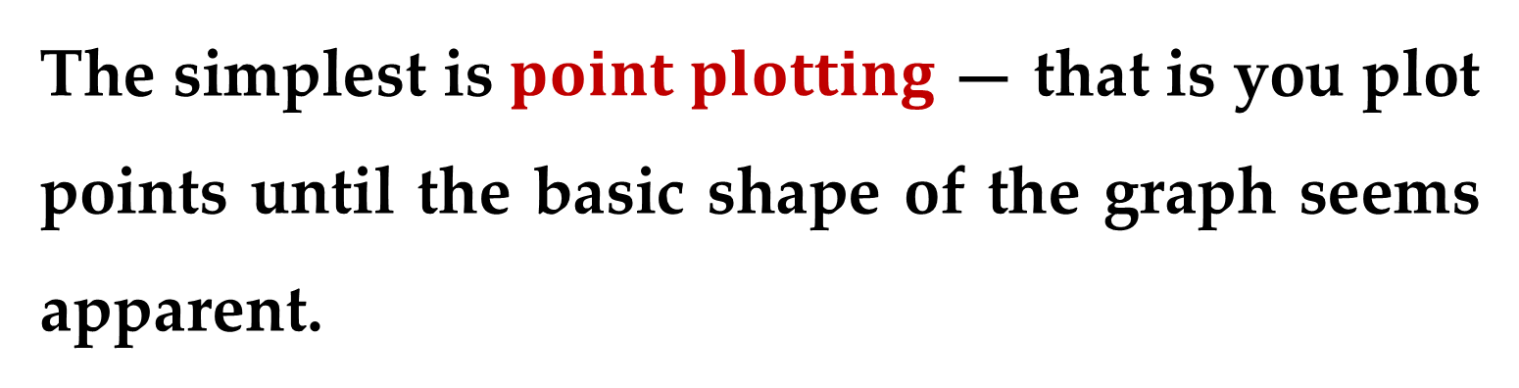
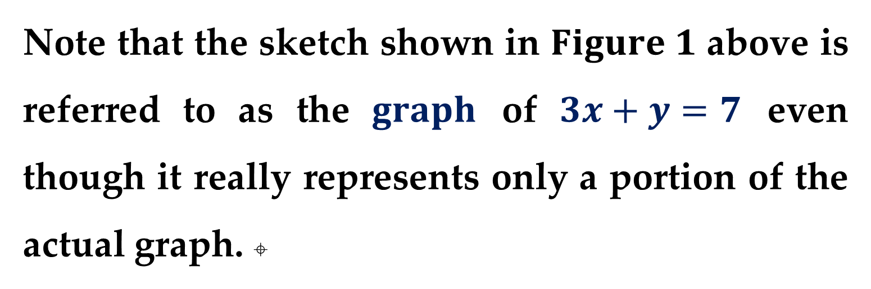
Note that the sketch shown in $Figure 1$ above is referred to as the $graph$ of $3x+y=7$ even though it really represents only a portion of the actual graph. 
In this course, you will study many graph sketching techniques.
The simplest is $point plotting$ — that is you plot points until the basic shape of the graph seems apparent.

Slide 10
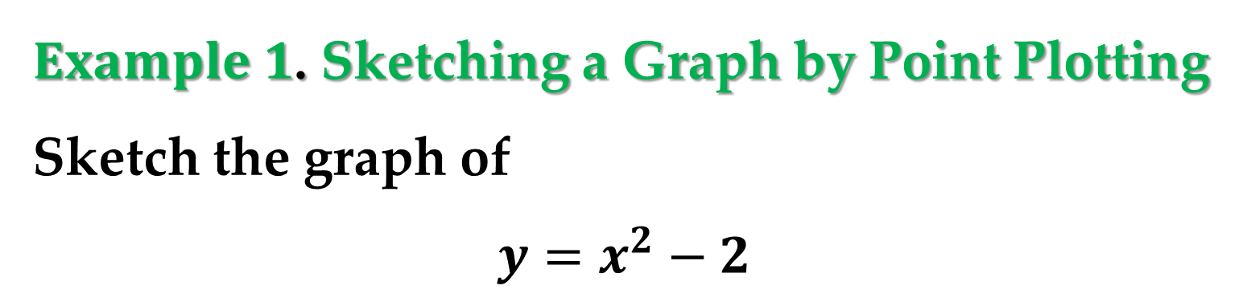

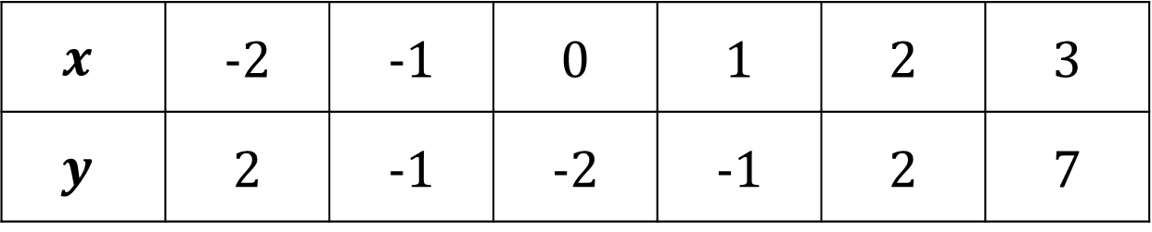
$Example 1$. Sketching a Graph by Point Plotting
Sketch the graph of
$$y=x^{2}−2$$
$Solution$
$1$. Construct a table of values
$$x$$ | -2 | -1 | 0 | 1 | 2 | 3
$$y$$ | 2 | -1 | -2 | -1 | 2 | 7
$2$. Plot the points shown in the table.

Slide 11
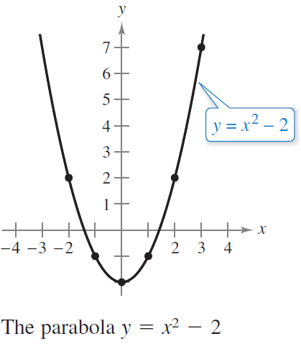
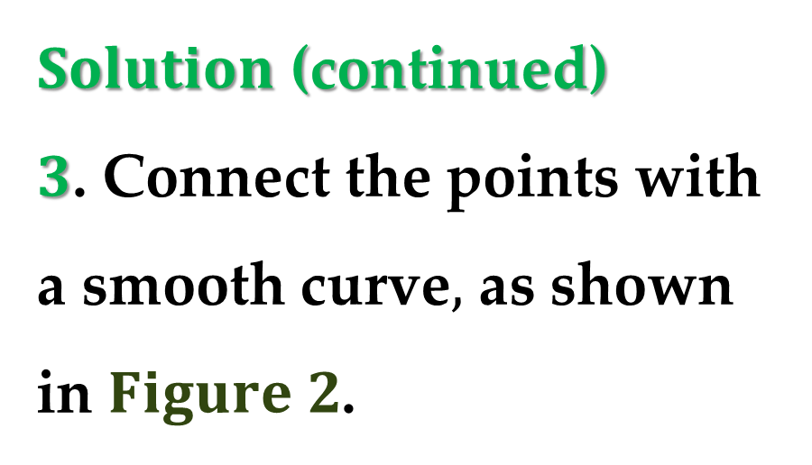
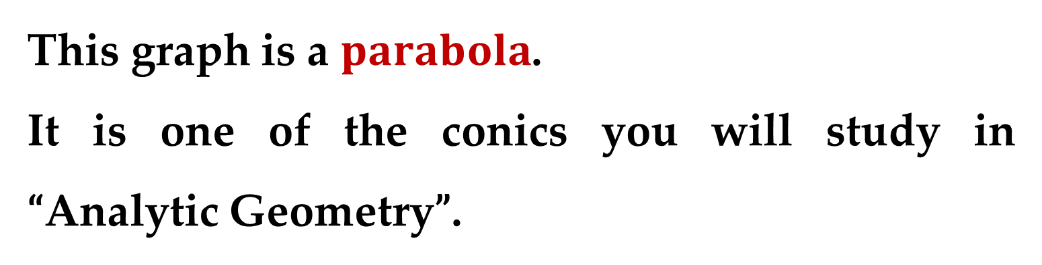
$Solution$ (continued)
$3$. Connect the points with a smooth curve$,$ as shown in $Figure 2$.
This graph is a $parabola$.
It is one of the conics you will study in “Analytic Geometry”.

Slide 12
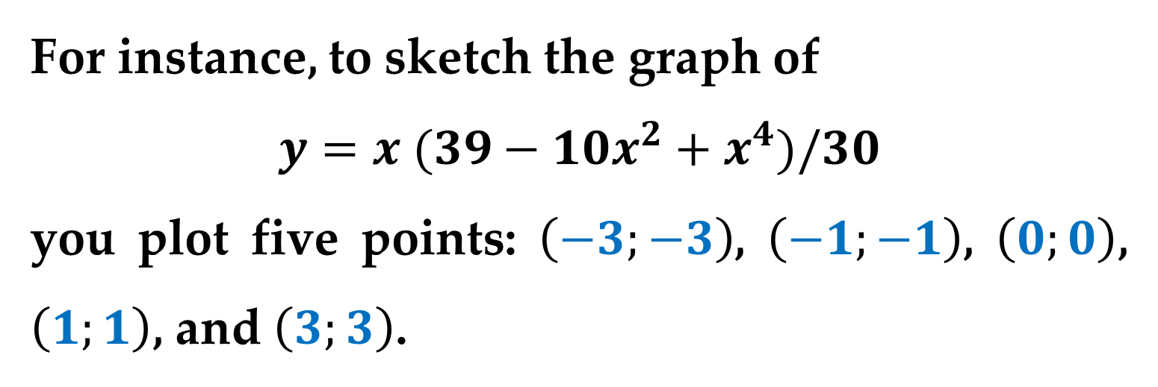
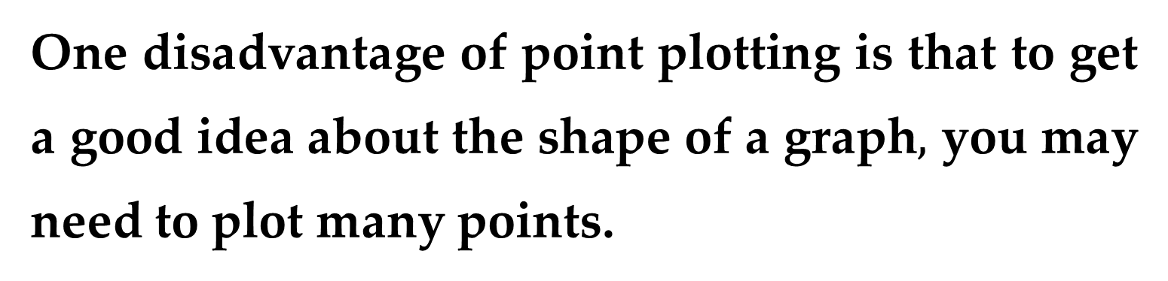
One disadvantage of point plotting is that to get a good idea about the shape of a graph$,$ you may need to plot many points.
With only a few points, you could badly misrepresent the graph.
For instance, to sketch the graph of
$$y=x (39−10x^{2}+x^{4})/30$$
you plot five points: $\left(−3;−3\right)$, $\left(−1;−1\right)$, $\left(0;0\right)$, $\left(1;1\right)$, and $\left(3;3\right)$.

Slide 13
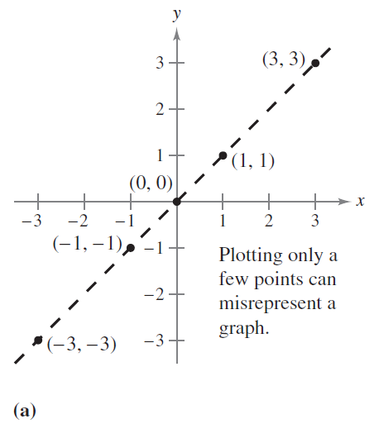
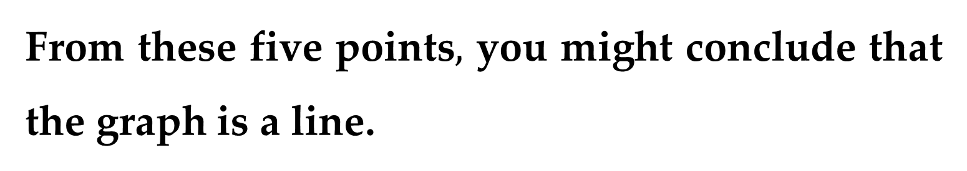
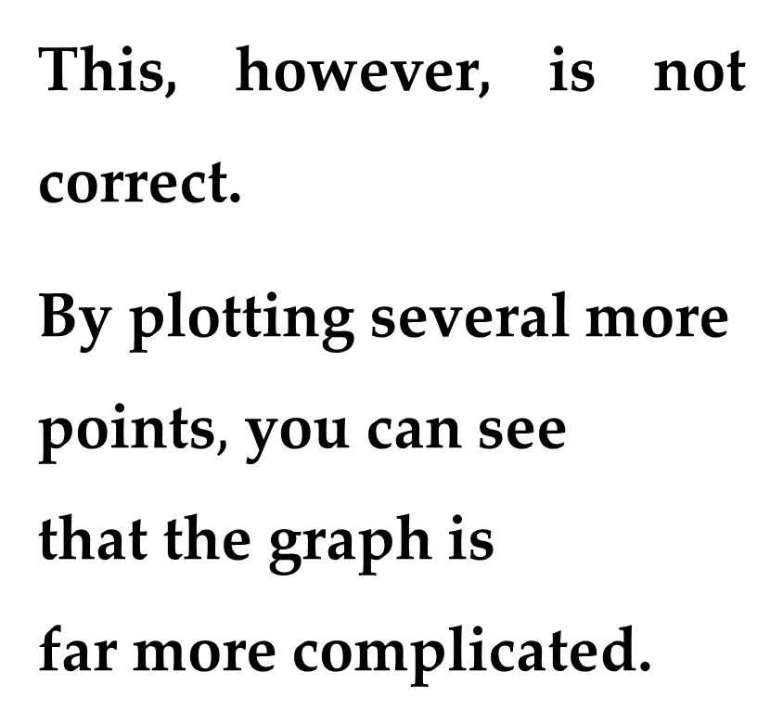
From these five points$,$ you might conclude that the graph is a line.
This, however, is not correct.
By plotting several more
points$,$ you can see
that the graph is
far more complicated.

Slide 14
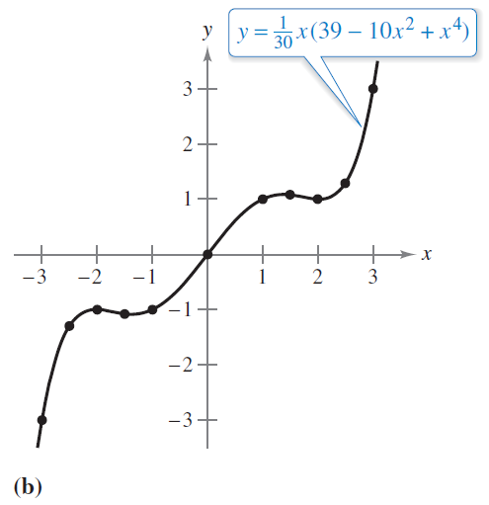
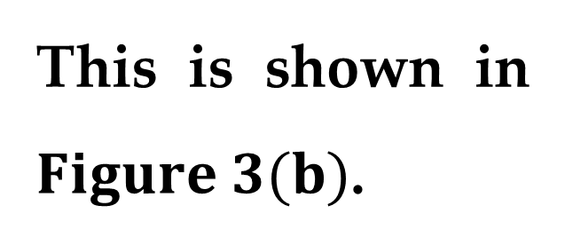
This is shown in $Figure 3(b)$.
Graphing an equation has been made easier by technology.
Even with technology, however, it is possible to misrepresent a graph badly.

Slide 15
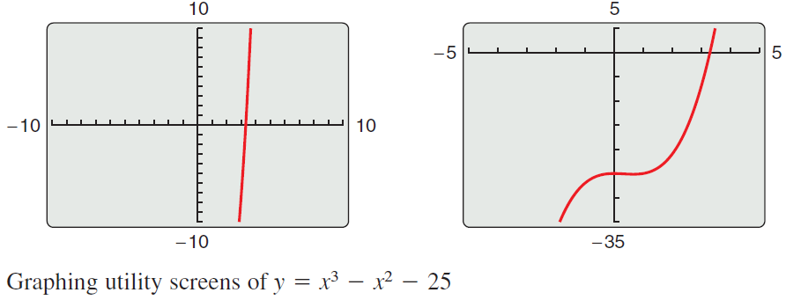
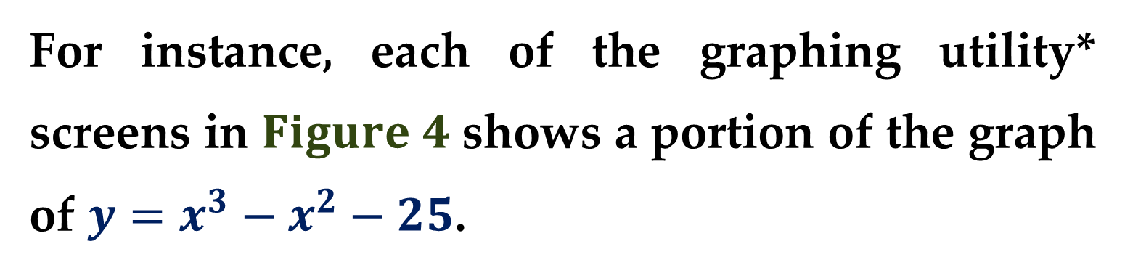
For instance, each of the graphing utility* screens in $Figure 4$ shows a portion of the graph of $y=x^{3}−x^{2}−25$.
From the screen on the left, you might assume that the graph is a line.

Slide 16
From the screen on the right, however, you can see that the graph is not a line.
So, whether you are sketching a graph by hand or using a graphing utility, you must realize that different “viewing windows” can produce very different views of a graph.
In choosing a viewing window, your goal is to show a view of the graph that fits well in the context of the problem.

Slide 17
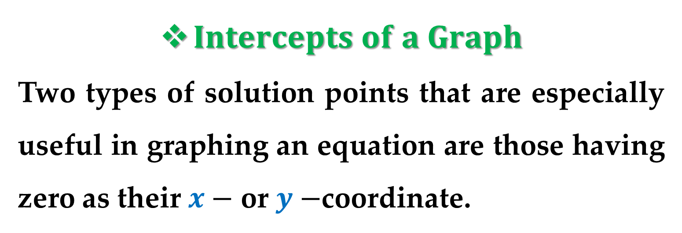
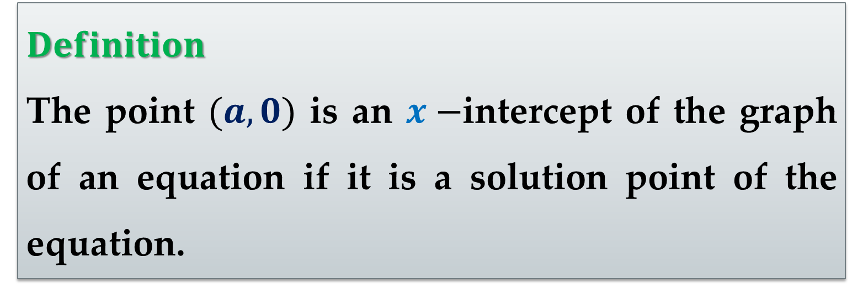
$Intercepts of a Graph$
Two types of solution points that are especially useful in graphing an equation are those having zero as their $x−$ or $y−$coordinate.
$Definition$
The point $(a,0)$ is an $x−$intercept of the graph of an equation if it is a solution point of the equation.

Slide 18
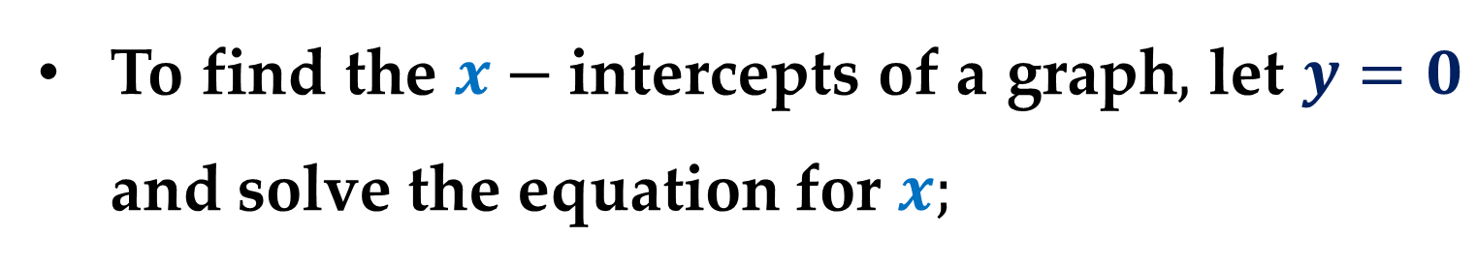
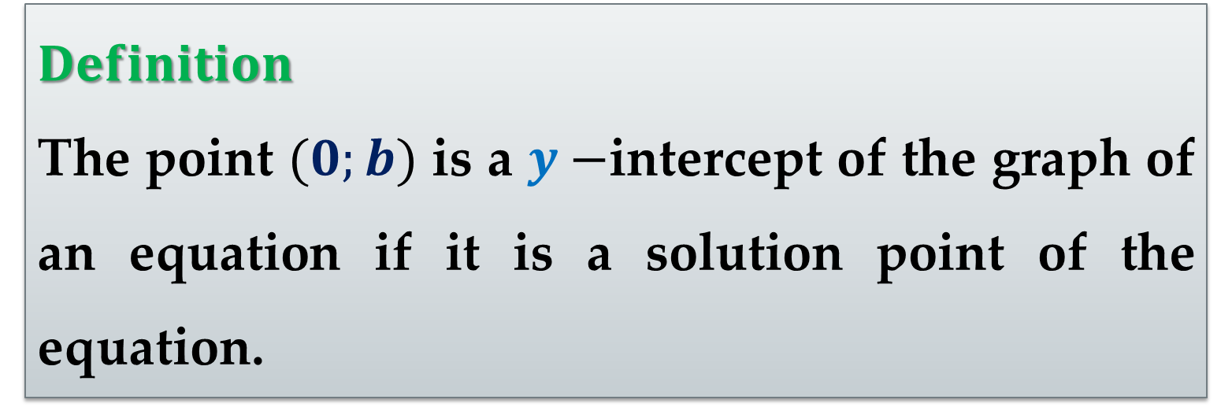
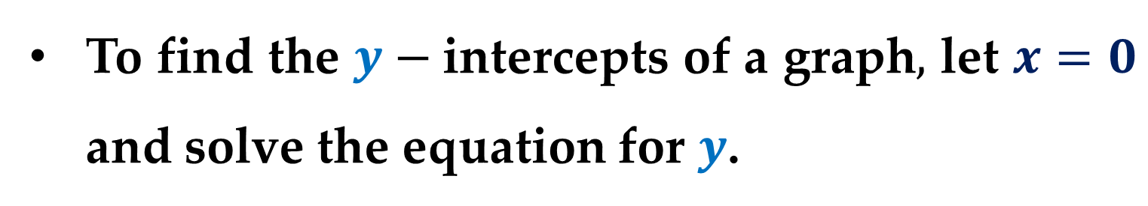
$Definition$
The point $(0;b)$ is a $y−$intercept of the graph of an equation if it is a solution point of the equation.
To find the $x−$intercepts of a graph$,$ let $y=0$ and solve the equation for $x;$
To find the $y−$intercepts of a graph$,$ let $x=0$ and solve the equation for $y$.

Slide 19
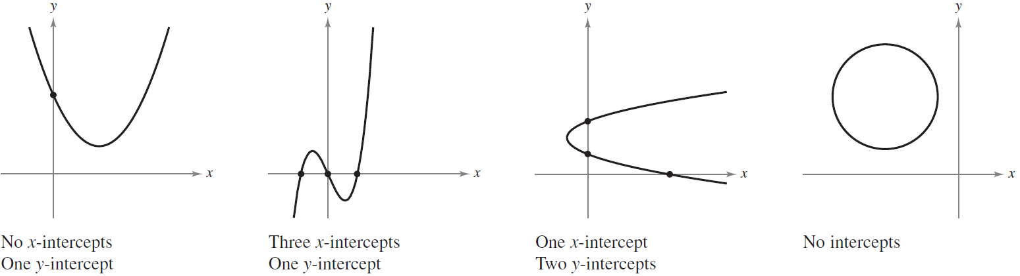
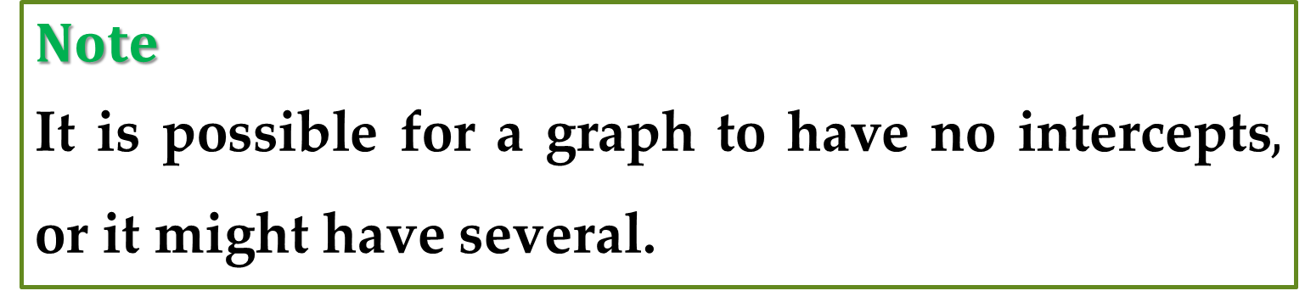
$Note$
It is possible for a graph to have no intercepts$,$ or it might have several.
Consider, for example, the four graphs shown in the following Figures.

Slide 20
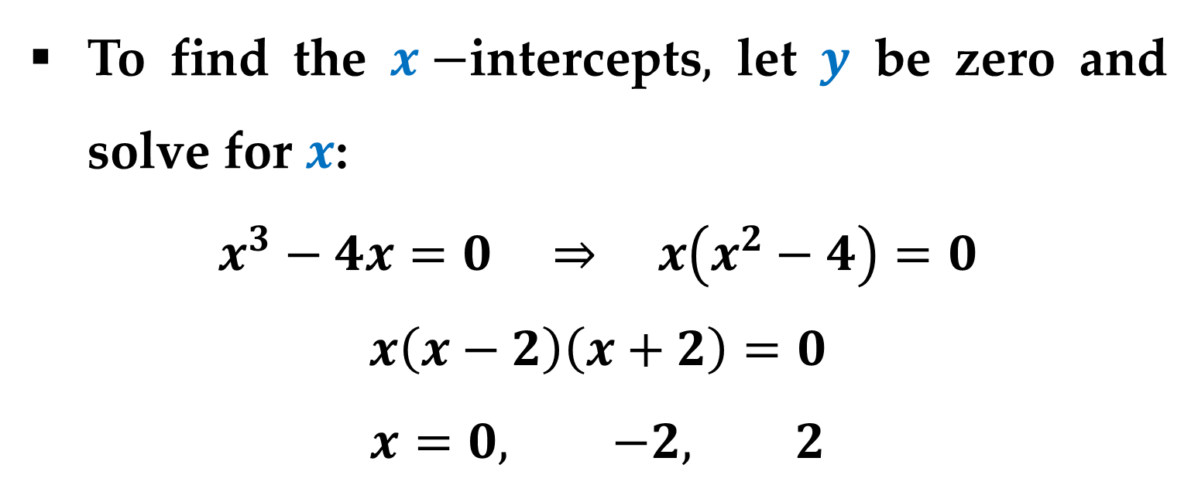
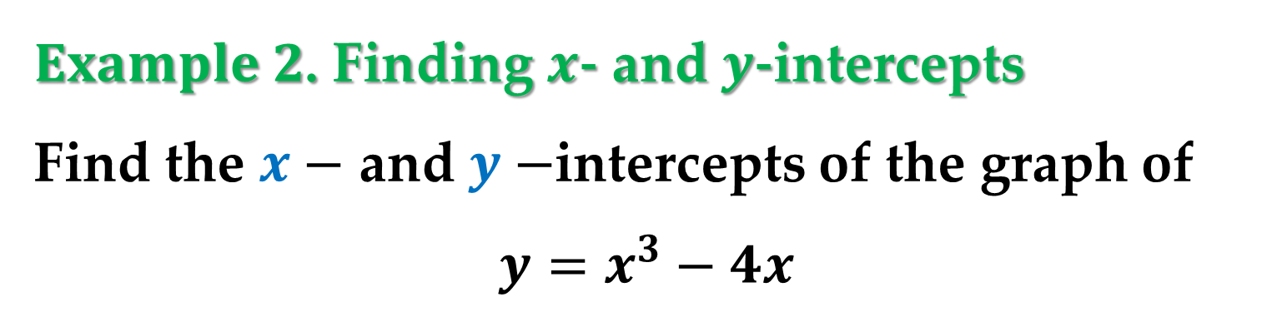
$Example 2$. Finding $x$- and $y$-intercepts
Find the $x−$ and $y−$intercepts of the graph of
$$y=x^{3}−4x$$
$Solution$
To find the $x−$intercepts$,$ let $y$ be zero and solve for $x$:
$$x^{3}−4x=0 ⇒ x\left(x^{2}−4\right)=0$$
$$x\left(x−2\right)\left(x+2\right)=0$$
$$x=0, −2, 2$$

Slide 21
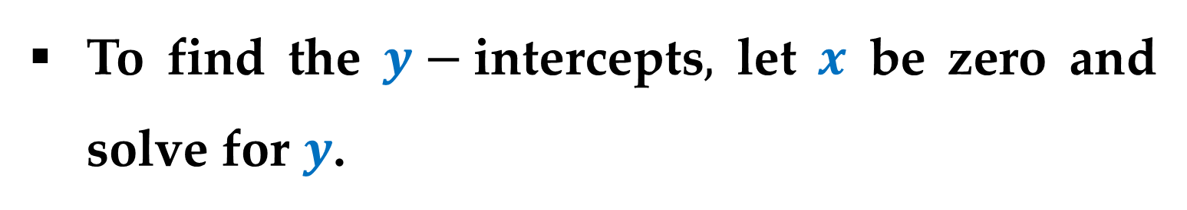
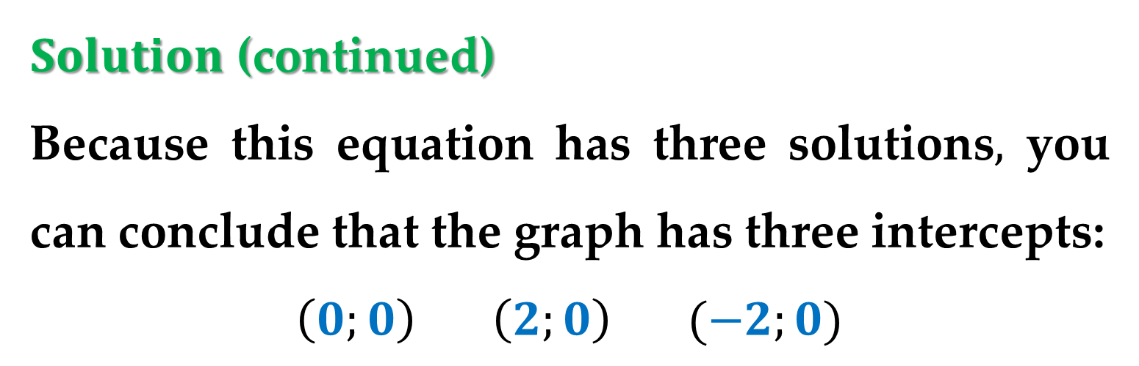
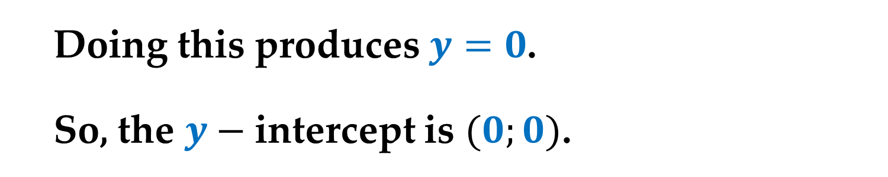
$Solution$ (continued)
Because this equation has three solutions$,$ you can conclude that the graph has three intercepts:
$$\left(0;0\right) \left(2;0\right) (−2;0)$$
To find the $y−$intercepts$,$ let $x$ be zero and solve for $y$.
Doing this produces $y=0$.
So, the $y−$intercept is $(0;0)$.

Slide 22
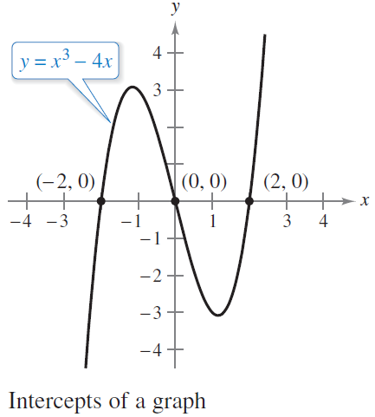

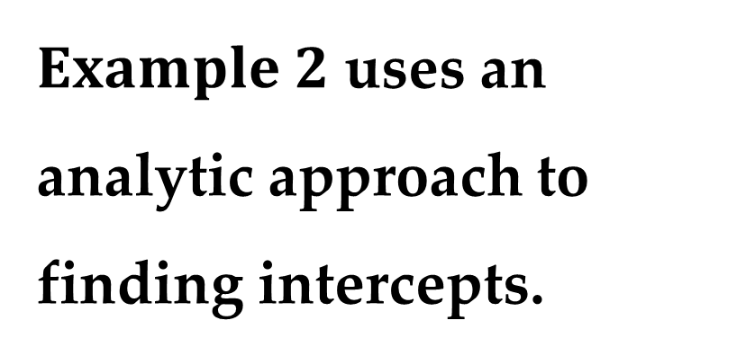
$Solution$ (continued)
$Example 2$ uses an analytic approach to finding intercepts.
When an analytic approach is not possible,
you can use a graphical approach by finding the points at which the graph intersects the axes.

Slide 23
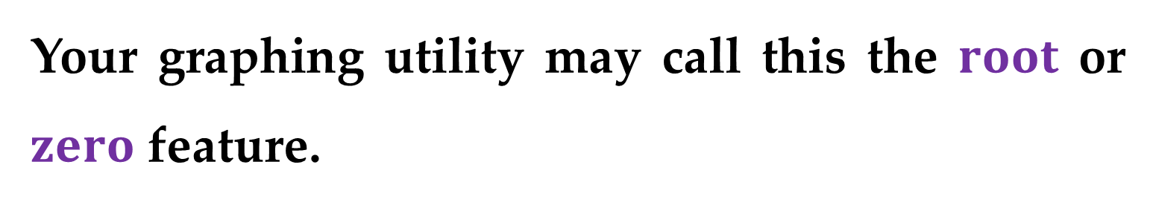
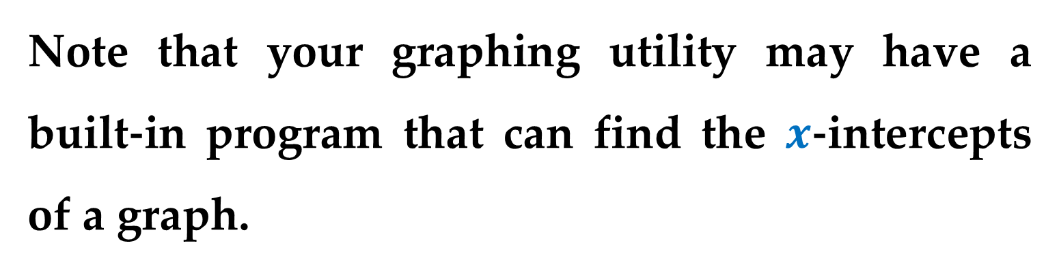

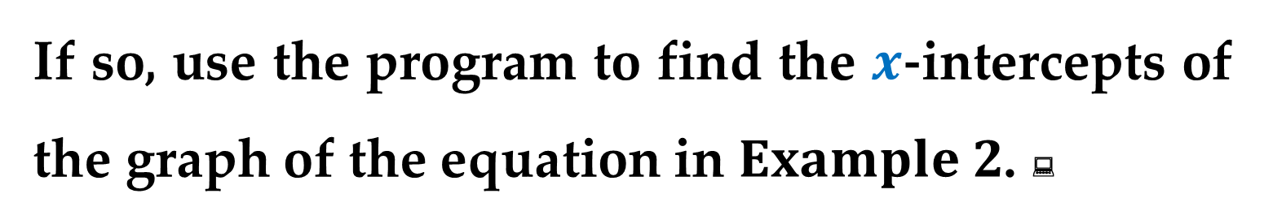
$Solution$ (continued)
Note that your graphing utility may have a built-in program that can find the $x$-intercepts of a graph.
Your graphing utility may call this the $root$ or $zero$ feature.
If so, use the program to find the $x$-intercepts of the graph of the equation in $Example 2$. 

Slide 24

$Symmetry of a Graph$
Knowing the symmetry of a graph before attempting to sketch it is useful because you may need only half as many points to sketch the graph.
There are three types of symmetry that can be used to help sketch the graphs of equations.

Slide 25


Symmetry with respect to the $y−$axis$;$
Symmetry with respect to the $x−$axis$;$
Symmetry with respect to the coordinate origin$.$
A graph is $symmetric with respect to the$ $y−axis$ if$,$ whenever $(x;y)$ is a point on the graph$,$ $(−x;y)$is also a point on the graph.

Slide 26



This means that the portion of the graph to the left of the $y−$axis is a mirror image of the portion to the right of the $y−$axis.
The graph of an equation in $x$ and $y$ is symmetric with respect to the $y−$axis if replacing $x$ by $−x$ yields an equivalent equation.

Slide 27



A graph is $symmetric with respect to the$ $x−axis$ if$,$ whenever $(x;y)$ is a point on the graph$,$ $(x;−y)$is also a point on the graph.
This means that the portion of the graph above the $x−$axis is a mirror image of the portion below the $x−$axis.

Slide 28


The graph of an equation in $x$ and $y$ is symmetric with respect to the $x−$axis if replacing $y$ by $−y$ yields an equivalent equation.
A graph is $symmetric with respect to the$ $coordinate origin$ if$,$ whenever $(x;y)$ is a point on the graph$,$ $(−x;−y)$is also a point on the graph.

Slide 29



This means that the graph is unchanged by a rotation of ${180}^{°}$ about the coordinate origin.
The graph of an equation in $x$ and $y$ is symmetric with respect to the origin if replacing $x$ by $−x$ and $y$ by $−y$
yields an equivalent
equation.

Slide 30


$Example 3$. $Testing for Symmetry$
Test the graph of $y=2x^{3}−x$ for symmetry with respect to $\left(a\right)$ the $y−$axis and $\left(b\right)$ the origin.
$Solution$
$\left(a\right)$ Testing for $y−$axis symmetry:
$$y=2x^{3}−x write original equation$$
$$y=2{\left(−x\right)}^{3}−\left(−x\right) replace x with −x$$
$$y=−2x^{3}+x simplify$$

Slide 31


$Solution$. $\left(continued\right)$
Because replacing $x$ by $−x$ does not yield an equivalent equation, you can conclude that the graph of $y=2x^{3}−x$ is not symmetric with respect to the $y−$axis.
$\left(b\right)$ Testing for symmetry with respect to the origin:
$$y=2x^{3}−x write original equation$$
$$\left(−y\right)=2{\left(−x\right)}^{3}−\left(−x\right) replace x by −x and y by −y$$

Slide 32



$Solution$. $\left(continued\right)$
$$−y=−2x^{3}+x simplify$$
$$y=2x^{3}−x equivalent equation$$
Because replacing $x$ by $−x$ and $y$ by $−y$ yields an equivalent equation, you can conclude that the graph of $y=2x^{3}−x$ is symmetric with respect to the origin, as shown in the $Figure$.

Slide 33

Solution (continued)
You can try testing for $x−$axis symmetry:
$$y=2x^{3}−x write original equation$$
$$\left(−y\right)=2x^{3}−x replace y by −y$$
$$y=−2x^{3}+x simplify$$
$Result$: There is no symmetry with respect to the $x−$axis.

Slide 34


$Example 4$. Using Intercepts and Symmetry to
Sketch a Graph
Sketch the graph of $x−y^{2}=1$.
Solution
The graph is symmetric with respect to the $x−$axis because replacing $y$ by $−y$ yields an equivalent equation:
$$x−y^{2}=1 → x−{\left(−y\right)}^{2}=1 → x−y^{2}=1$$

Slide 35



$Solution$. $\left(continued\right)$
This means that the portion of the graph below the $x−$axis is a mirror image of the portion above the $x−$axis.
To sketch the graph$,$ first plot the $x−$intercept and the points above the $x−$axis.

Slide 36



$Solution$. $\left(continued\right)$
Then reflect in the $x−$axis to obtain the entire graph$,$ as shown in Figure.
Note that graphing utilities are designed so that they most easily graph equations in which $y$ is a function of $x$.

Slide 37

To graph other types of equations, you need to split the graph into two or more parts or you need to use a different graphing mode.
To graph the equation in this $Example,$ you can split it into two parts, if you resolve the equation with respect to the variable $y$:
$$y_{1}=\sqrt{x−1} top portion of graph$$
$${ y}_{2}=−\sqrt{x−1} bottom portion of graph$$

Slide 38


$Points of Intersection$
You can find the point(s) of intersection of two graphs by solving their equations simultaneously.
$Definition$
A $point of intersection$ of the graphs of two equations is a point that satisfies both equations.

Slide 39



$Example 5$. $Finding Points of Intersection$
Find all points of intersection of the graphs of
$x^{2}−y=3$ and $x−y=1$
Solution
Begin by sketching the graphs of both equations on the same rectangular coordinate system, as shown in the $Figure$.

Slide 40


$Solution$. $\left(continued\right)$
Having done this, it appears that the graphs have two points of intersection.
You can find these two points as follows:
$$y=x^{2}−3$$
$$y= x−1$$
$$x^{2}−3=x−1 → x^{2}−x−2=0$$
$$\left(x−2\right)\left(x+1\right)=0 → x=2, x=−1$$

Slide 41



$Solution$. $\left(continued\right)$
The corresponding values of $y$ are obtained by substituting $x=−2$ and $x=−1$ into either of the original equations.
Doing this produces two points of intersection:
$(2;1)$ and $(−1;−2)$
You can check the points of intersection in $Example 5$ by substituting into both of the original equations.

Slide 42


$Mathematical Models$
Real-life applications of mathematics often use equations as $mathematical models$.
In developing a mathematical model to represent actual data, you should strive for two (often conflicting) goals:
Accuracy$;$
Simplicity$.$

Slide 43

That is$,$
on the one hand$,$ you want the model to be simple enough to be workable$;$
on the other hand$,$ you want the model to be accurate enough to produce meaningful results.

Slide 44



$Example 6$. $Comparing Two Mathematical$
$$Models$$
The Mauna Loa Observatory in Hawaii records the carbon dioxide concentration (in parts per million) in Earth$’$s atmosphere.

Slide 45


$Example 6$. (continued)
The January readings for various years are shown in the $Figure$.

Slide 46

Example 6. (continued)
In the July $1990$ issue of $Scientific American,$ these data were used to predict the carbon dioxide level in Earth$’$s atmosphere in the year $2035,$ using the quadratic model:
$$y=316.2+0.70t+0.018t^{2}$$
where $t=0$ represents $1960,$ as shown in Figure $(a)$ above.

Slide 47


Example 6. (continued)
The data shown in Figure $(b)$ above represent the years $1980$ through $2010$ and can be modeled by:
$$y=303.5+1.68t$$
where again $t=0$ represents $1960$.
$Question \#1$
What was the prediction given in the $Scientific American$ article in $1990$?

Slide 48


$Question \#2$
Given the new data for $1990$through $2010,$ does this prediction for the year $2035$seem accurate?
Solution
To answer the first question$,$ substitute $t=75$ (for the year $2035$) into the quadratic model to obtain:
$$y=316.2+0.70\left(75\right)+0.018{\left(75\right)}^{2}=469.95$$

Slide 49


Solution (continued)
So$,$ the prediction in the $Scientific American$ article was that the carbon dioxide concentration in Earth$’$s atmosphere would reach about $470$ parts per million in the year $2035$.
Using the linear model for the $1980–2010$ data$,$ the prediction for the year $2035$is
$$y=303.5+1.68\left(75\right)=429.5$$

Slide 50


So$,$ based on the linear model for $1980–2010,$ it appears that the $1990$ prediction was actually too high.
Using the same linear and quadratic models, we can make a prediction about the current year (i.e. $2020$):
$$y_{l}=303.5+1.68\left(60\right) =404.3000$$
$$y_{q}=316.2+0.70\left(60\right)+0.018{\left(60\right)}^{2}=423.00$$

Slide 51


Slide 52

References
Calculus 10th Edition

Slide 53

References
Calculus 7th Edition

Slide 54

References
Calculus 10th Edition

Slide 55

References
Calculus: An Intuitive and Physical Approach (Second Edition) (Dover Books on Mathematics)

Slide 56

References
College Mathematics for Business, Economics, Life Sciences, and Social Sciences (13th Edition)

Slide 57
Thank you for attention.

